Slide 1
Hungry Snake Game
By: Kenneth grassel
https://github.com/ksu-is/SnakeGameProject

Slide 2
Tag Line introduction
My project is a simple game of snake. The point of the game is to grow your snake by eating red apples that randomly spawn throughout the screen. The game is run through the pygame extension in python. Most of the game structure is imported from another build. I changed the appearance of the game to the best of my ability and added some colors. I also Added a loading title screen and a gave over screen as well as adding a replay function.

Slide 3
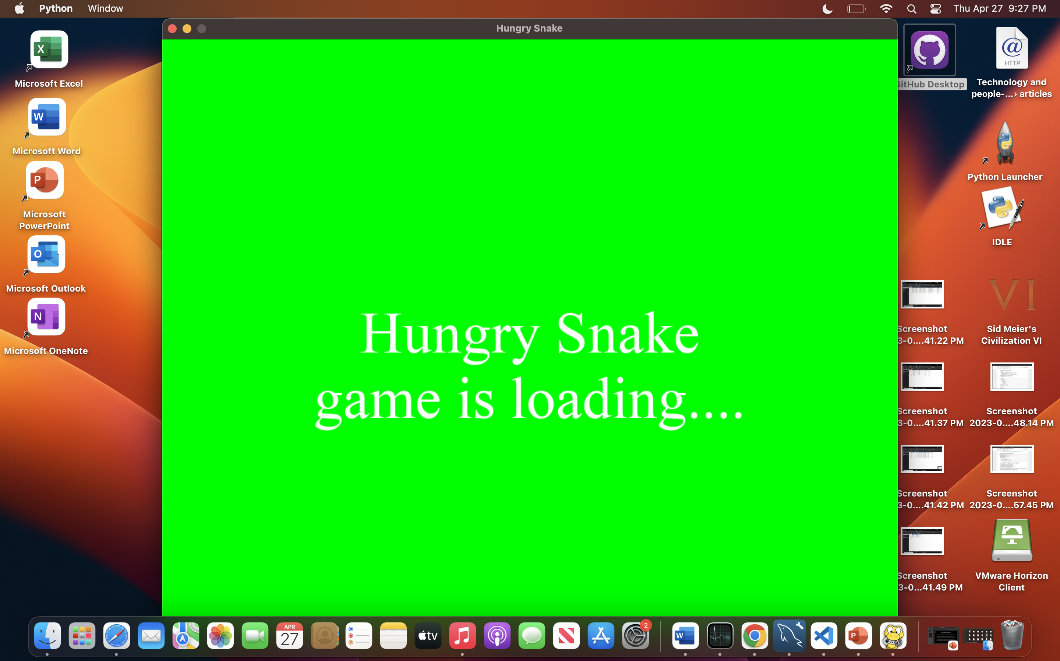
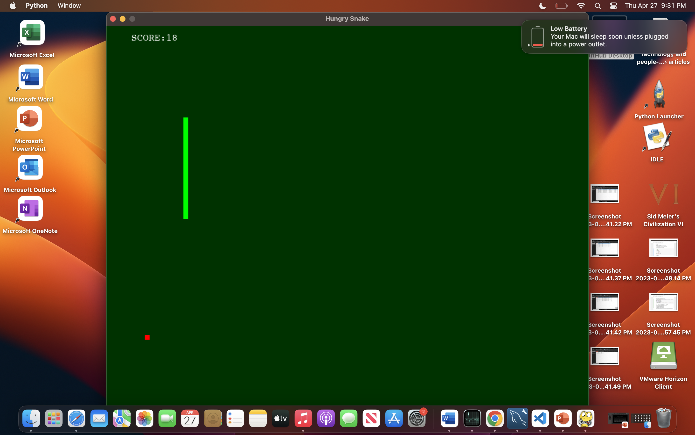
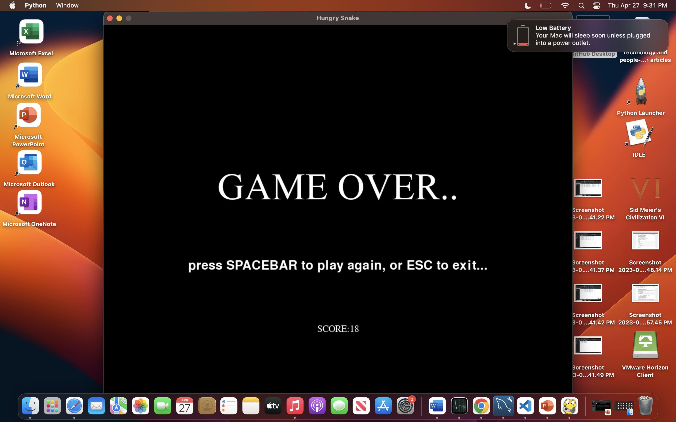
Screenshots

